Slide 1
Steuben County School Districts 2015 Prevention Needs Assessment Survey Results
Steuben Prevention Coalition

Slide 2
Characteristics of Participants
Total Number of Students = 2,357
Number of males = 1,130
Number of females = 1,227
By Grades: 8th = 907
10th = 877
12th = 573

Slide 3
1. Addison CSD 2. Arkport CSD 3. Avoca CSD 4. Bath CSD 5. Campbell/Savona CSD 6. Canisteo/Greenwood CSD 7. Corning School District 8. Hammondsport CSD 9. Hornell City School District 10. Prattsburgh CSD 11. Wayland/Cohocton CSD
Participating School Districts

Slide 10
Steuben County 8th Grade
Trend Data – October - 2015

Slide 11
Steuben County 10th Grade
Trend Data – October - 2015

Slide 12
Steuben County 12th Grade
Trend Data – October 2015

Slide 13
8th Grade Problem Behaviors - 2015

Slide 14
10th Grade Problem Behaviors - 2015

Slide 15
12th Grade Problem Behaviors

Slide 16
Steuben County Core Measures 2015
Grade 8
Core Measure | Substance |  | % of Students per Year |  |  |  |  | Number of Students Participated per Year
 |  |  | 2015 | 2014 | 2012 | 2010 |  | 2015 | 2014 | 2012 | 2010
30 Day Use | Alcohol |  | 8.8% | 11.2% | 15.9% | 16.2% |  | 867 | 804 | 703 | 160
 | Tobacco |  | 5.3% | 4.2% | 8.5% | 11.6% |  | 862 | 804 | 696 | 114
 | Marijuana |  | 5.4% | 4.5% | 6.7% | 8.3% |  | 866 | 807 | 700 | 82
 | Prescription Drugs |  | 2.1% | N/A | N/A | N/A |  | 869 | N/A | N/A | N/A
Perception of Risk (people are at moderate or great risk of harming themselves) | Alcohol |  | 72.1% | 67.8% | 65.4% | 72.3% |  | 868 | 803 | 690 | 713
 | Tobacco |  | 84.8% | 86.1% | 82.5% | 86.7% |  | 870 | 808 | 696 | 855
 | Marijuana |  | 69.2% | 69.9% | 79.5% | 65.0% |  | 868 | 804 | 684 | 641
Perception of Parental Disapproval (Parents feel it would be wrong or very wrong to use) | Alcohol |  | 97.8% | 97.5% | 91.7% | 88.6% |  | 827 | 771 | 661 | 874
 | Tobacco |  | 96.4% | 96.7% | 95.3% | 95.1% |  | 828 | 777 | 661 | 938
 | Marijuana |  | 93.8% | 96.1% | 96.2% | 96.2% |  | 823 | 773 | 654 | 949
Perception of Peer Disapproval (It is wrong or very wrong for someone my age to use) | Alcohol |  | 89.5% | 87.0% | 81.6% | N/A |  | 886 | 820 | 707 | N/A
 | Tobacco |  | 89.6% | 89.5% | 86.1% | N/A |  | 885 | 820 | 706 | N/A
 | Marijuana |  | 89.6% | 85.6% | 87.1% | N/A |  | 885 | 815 | 706 | N/A
Average Age of Onset | Substance |  | AGE |  |  |  |  | Number of Students Participated per Year
 |  |  |  |  |  |  |  | 2015 | 2014 | 2012 | 2010
 | Alcohol |  | 11.6 | 11.6 | 11.7 | 11.8 |  | 257 | 278 | 315 | N/A
 | Tobacco |  | 11.3 | 11.5 | 11.5 | 11.5 |  | 135 | 142 | 180 | N/A
 | Marijuana |  | 12.3 | 12.3 | 12.3 | 12.2 |  | 78 | 85 | 95 | N/A
 | Prescription Pain Relievers |  | 11.6 | N/A | N/A | N/A |  | 47 | 609 | N/A | N/A

Slide 17
Steuben County Core Measures 2015
Grade 10
Core Measure | Substance |  | % of Students per Year |  |  |  |  | Number of Students Participated per Year
 |  |  | 2015 | 2014 | 2012 | 2010 |  | 2015 | 2014 | 2012 | 2010
30 Day Use | Alcohol |  | 19.0% | 27.5% | 32.2% | 30.8% |  | 851 | 611 | 546 | 696
 | Tobacco |  | 7.0% | 10.8% | 14.3% | 19.9% |  | 842 | 610 | 537 | 191
 | Marijuana |  | 11.0% | 14.9% | 15.8% | 18.6% |  | 844 | 610 | 538 | 179
 | Prescription Drugs |  | 3.0% | 4.8% | N/A | N/A |  | 845 | 609 | N/A | N/A
Perception of Risk (people are at moderate or great risk of harming themselves) | Alcohol |  | 72.6% | 66.1% | 65.9% | 67.6% |  | 847 | 617 | 551 | 649
 | Tobacco |  | 85.1% | 83.6% | 85.4% | 85.5% |  | 870 | 617 | 553 | 821
 | Marijuana |  | 55.8% | 51.5% | 73.8% | 47.6% |  | 848 | 615 | 543 | 457
Perception of Parental Disapproval (Parents feel it would be wrong or very wrong to use) | Alcohol |  | 96.1% | 94.5% | 82.5% | 76.9% |  | 824 | 595 | 521 | 736
 | Tobacco |  | 96.0% | 92.8% | 92.7% | 90.1% |  | 824 | 597 | 519 | 865
 | Marijuana |  | 91.5% | 90.1% | 90.5% | 91.8% |  | 822 | 597 | 514 | 881
Perception of Peer Disapproval (It is wrong or very wrong for someone my age to use) | Alcohol |  | 79.9% | 67.4% | 65.1% | N/A |  | 862 | 629 | 576 | N/A
 | Tobacco |  | 84.5% | 73.8% | 74.1% | N/A |  | 862 | 629 | 571 | N/A
 | Marijuana |  | 73.3% | 62.8% | 72.1% | N/A |  | 858 | 629 | 573 | N/A
Average Age of Onset | Substance |  | AGE |  |  |  |  | Number of Students Participated per Year
 |  |  |  |  |  |  |  | 2015 | 2014 | 2012 | 2010
 | Alcohol |  | 13.2 | 13.3 | 13.2 | 13 |  | 403 | 386 | 362 | N/A
 | Tobacco |  | 12.7 | 12.9 | 12.6 | 12.5 |  | 189 | 191 | 194 | N/A
 | Marijuana |  | 13.7 | 13.8 | 13.7 | 13.4 |  | 189 | 178 | 173 | N/A
 | Prescription Pain Relievers |  | 12.9 | N/A | N/A | N/A |  | 55 | 609 | N/A | N/A

Slide 18
Steuben County Core Measures 2015
Grade 12
Core Measure | Substance |  | % of Students per Year |  |  |  |  | Number of Students Participated per Year
 |  |  | 2015 | 2014 | 2012 | 2010 |  | 2015 | 2014 | 2012 | 2010
30 Day Use | Alcohol |  | 38.0% | N/A | N/A | N/A |  | 548 | N/A | N/A | N/A
 | Tobacco |  | 10.8% | N/A | N/A | N/A |  | 544 | N/A | N/A | N/A
 | Marijuana |  | 19.6% | N/A | N/A | N/A |  | 545 | N/A | N/A | N/A
 | Prescription Drugs |  | 5.5% | N/A | N/A | N/A |  | 547 | N/A | N/A | N/A
Perception of Risk (people are at moderate or great risk of harming themselves) | Alcohol |  | 64.2% | N/A | N/A | N/A |  | 550 | N/A | N/A | N/A
 | Tobacco |  | 79.0% | N/A | N/A | N/A |  | 548 | N/A | N/A | N/A
 | Marijuana |  | 35.9% | N/A | N/A | N/A |  | 551 | N/A | N/A | N/A
Perception of Parental Disapproval (Parents feel it would be wrong or very wrong to use) | Alcohol |  | 93.4% | N/A | N/A | N/A |  | 534 | N/A | N/A | N/A
 | Tobacco |  | 89.1% | N/A | N/A | N/A |  | 533 | N/A | N/A | N/A
 | Marijuana |  | 82.7% | N/A | N/A | N/A |  | 532 | N/A | N/A | N/A
Perception of Peer Disapproval (It is wrong or very wrong for someone my age to use) | Alcohol |  | 60.2% | N/A | N/A | N/A |  | 555 | N/A | N/A | N/A
 | Tobacco |  | 66.5% | N/A | N/A | N/A |  | 553 | N/A | N/A | N/A
 | Marijuana |  | 53.4% | N/A | N/A | N/A |  | 554 | N/A | N/A | N/A
Average Age of Onset | Substance |  | AGE |  |  |  |  | Number of Students Participated per Year
 |  |  |  |  |  |  |  | 2015 | 2014 | 2012 | 2010
 | Alcohol |  | 14.3 | N/A | N/A | N/A |  | 381 | N/A | N/A | N/A
 | Tobacco |  | 13.8 | N/A | N/A | N/A |  | 189 | N/A | N/A | N/A
 | Marijuana |  | 14.6 | N/A | N/A | N/A |  | 216 | N/A | N/A | N/A
 | Prescription Pain Relievers |  | 14.9 | N/A | N/A | N/A |  | 55 | N/A | N/A | N/A

Slide 19
School Data Presentations 9 out of 11 completed thus far.

Slide 20
STOP Grant
We are applying for a Sober Truth on Preventing Underage Drinking Act Grant.
Grant was submitted yesterday.
Grant is for $50,000/year for four years.
Purpose is to “prevent and reduce alcohol use among youth in communities throughout the U.S. and strengthen collaboration among communities.

Slide 21
Other Upcoming Programs
DITEP (Drug Impairment Training for Education Professionals – July 6th and 7th.
“Tall Cop” Program – March 9, 2017 6:00pm – 7:30pm and March 10, 2017 9:00am – 3:00pm.

Slide 22
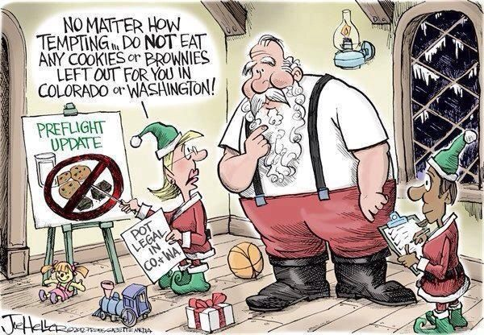

Slide 23
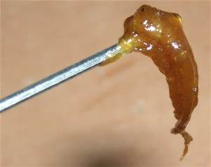
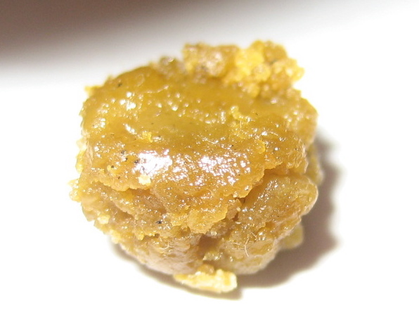
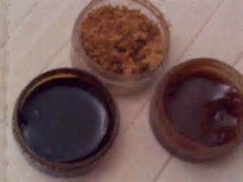
THC Ear Wax and Butane Hash Oil – 90% Pure THC

Slide 24
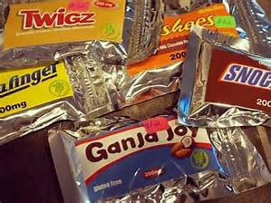
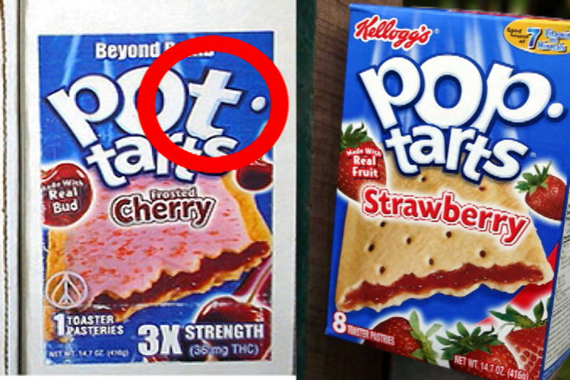
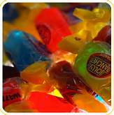
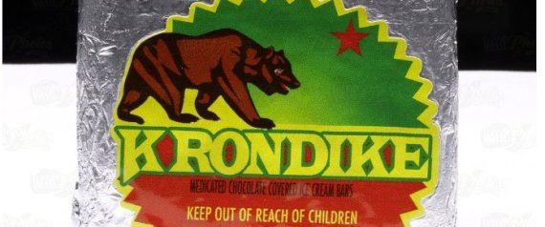
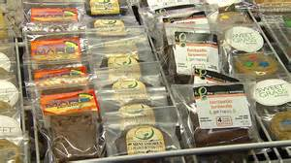
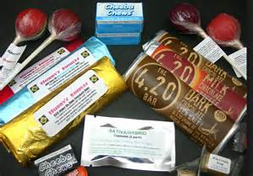
Marijuana Edibles

