Slide 2
The Steuben Prevention Coalition is a Community Effort
Our membership includes representation from the following:
Steuben Council on Addictions Catholic Charities of Steuben
Family Service Society Steuben County Public Health Dept.
Hornell Area Concern for Youth High School Students
New York State Troopers Bath Elks Club
Steuben County Sheriff’s Dept. STTAC/Reality Check
Hornell Police Department Steuben County Administration
Bath Police Department Steuben Trust Company
District Attorney’s Office National Guard
WVIN 98.3 Arbor Development
Center for Dispute Settlement School Resource Officers
School Districts Steuben County Probation Dept.
Kinship Family Services Steuben County Community Services
Dept. of Social Services Hornell Elks Club
Steuben Co. Youth Bureau Institute for Human Services
St. James Mercy Hospital New Hope Wesleyan Church – Hornell
Prevention Resource Center Hornell Partners for Growth
Triangle Fund Foundation Corning & So. Tier Finger Lakes Tourism

Slide 3
What WE Do
1. Collect Data
a. Student survey – every two years
b. Student focus groups – in-between survey years
c. Adult Perception Survey – every year
d. Key informant interviews – every two years
2. Present schools with their individual data.
3. Youth Action Forum
4. Develop working relationships with Law Enforcement agencies
in Steuben County
5. Develop partnerships with all 13 school districts
6. Implement Drug Impairment Program for Education
Professionals (DITEP)

Slide 4
What We Do (continued)
7. Promote evidenced based prevention programs in all
county school districts
8. Help develop school Codes of Conduct and
athletic policies
9. Produce a monthly newsletter
10. Advance Social Media – Website/Facebook/Twitter
11. Sponsor and participate in community awareness programs

Slide 5
Student Data 2010 - 2015
A new student survey will be administered in October 2017

Slide 6
Steuben County 8th Grade
Trend Data – October - 2015

Slide 7
Steuben County 10th Grade
Trend Data – October - 2015

Slide 8
Steuben County 12th Grade
Trend Data – October 2015

Slide 9
Upcoming projects
Youth Engagement Program
PSA Creations
Videos for Facebook & Website
Youth Newsletter Article
Youth Community Service & Volunteering
Town Hall Meeting on Marijuana
Social Host Education Campaign
Sticker Shock Program
Key Informant Interviews
Focus Groups
Drug Quiz
DUNK Distracted Driving Event
Marijuana Education Campaign
2018 Prom & Graduation Awareness Activities

Slide 10
Successes - Accomplishments
Social Host Law
Development & Continuation of Annual Youth Action Forum
Annual Sticker Shock Program
Social Media – Facebook – Website
Monthly Newsletter – “Ounce of Prevention”
TIPS for the Tool Box Series
Annual DITEP Training
Annual TIPS Training
Tall Cop Event w/Jermaine Galloway
Convening of School Policy Group
Marijuana Fatal Vision Simulation Kit
Reductions in usage of Alcohol, Marijuana & Tobacco by our youth:
8th Grade Alcohol use down 43%
8th Grade Tobacco use down 54%
8th Grade Marijuana use down 35%
10th Grade Alcohol use down 35%
10th Grade Tobacco use down 63%
10th Grade Marijuana use down 41%

Slide 11
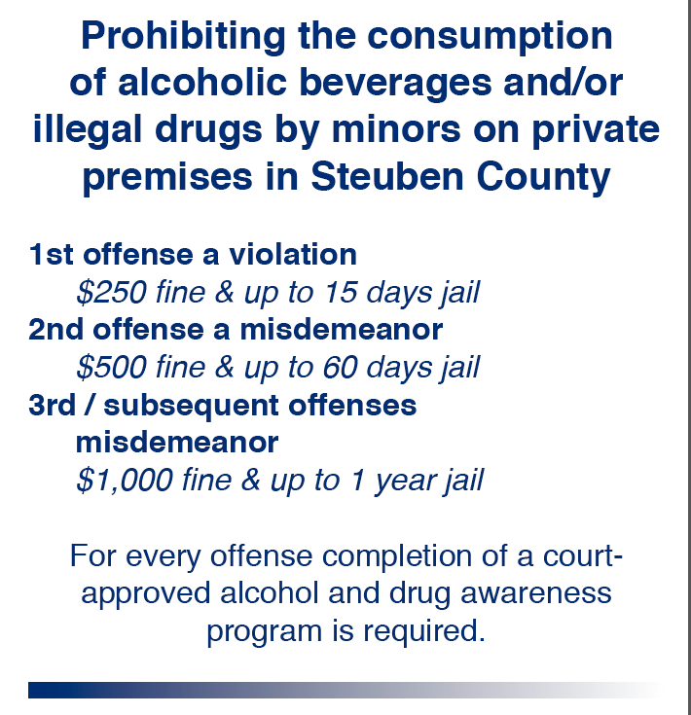

Slide 12
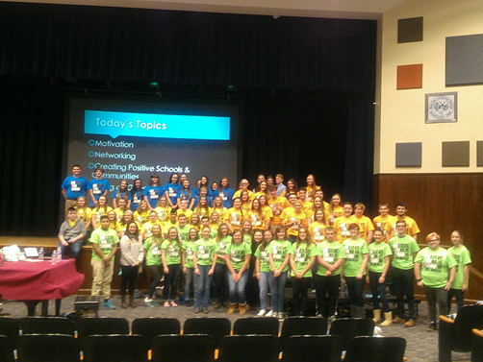
Motivation
Internal and external factors that stimulate desire and energy in people to be continually interested and committed to a job, role or subject, or to make an effort to attain a goal. (Speaker – Mrs. Amy Rusak, Pro Action of Steuben & Yates Counties)
Networking
Making contacts, exchanging information and developing relationships that can become mutually beneficial. (Speaker – Mrs. Stacey Brzezinski, Haverling High School)
Positive School Climate & Presenting Ideas
Creating positive school climates can decrease negative behaviors and increase positive outcomes for both students and staff. Learning what works from other schools and making changes to fit your school is essential. After developing your ideas you need to know how to present them in order to get support. (Speaker – Mrs. Amy Brewer, Haverling High School)
What Does It Mean to be a Good Leader
A leader is someone who brings people together and guides them towards a common goal. Anyone can tell others what to do, but effective leadership requires much more than the ability to assign tasks to a group. (Speaker – Mrs. Pam Colomiao, Chemung Canal Trust Company)

Slide 13
Website – Facebook – Social Media
www.steubenpreventioncoalition.org

Slide 14
What you can find on the Coalition Website
Resources
Community Service Opportunities
Membership/Volunteer Opportunities
Internship Opportunities
Sticker Shock Program
Public Service Announcement Projects
Peer to Peer Messaging
Shadowing Experiences
Youth Newsletter Article
Coalition Events
Assistance with child care
Assistance with table displays
Coalition Mailings
www.steubenpreventioncoalition.org
Make a Difference

Slide 15
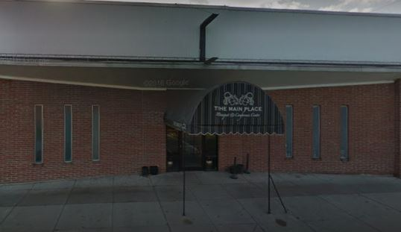
Proud Sponsor of the 2017 Youth Action Forum
The Main Place
251 Main Street
Hornell, New York 14843

Slide 16
Contact Us:
Norman McCumiskey, Program Coordinator
(607) 776-6441, ext. 208
nmccumiskey@dor.org
Colleen Banik, Assistant Program Coordinator
(607) 776-6441, ext. 202
cbanik@dor.org
www.steubenpreventioncoalition.org

