Slide 1
A Message from the
Steuben Prevention Coalition
Steuben County Task Force
on Marijuana
Prevention
www.steubenpreventioncoalition.org
607-776-6441

Slide 2
What is the potency of today’s marijuana?
Approximately 10 times stronger than the marijuana from the 1970’s.
THC levels began to be monitored in the 1970’s and it has been found that potency levels have been steadily rising over the years. This increase has also coincided with increased emergency room visits and admissions to drug treatment programs especially among our teens.

Slide 3
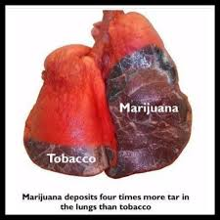
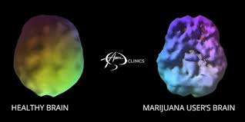
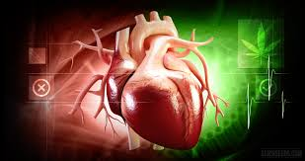
In addition to causing trouble in the brain, smoking marijuana may increase the risk of heart attacks and respiratory illnesses.

Slide 4
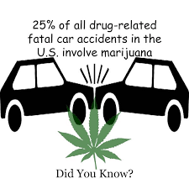
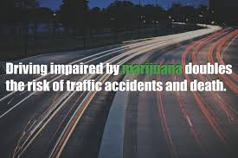
Drivers on marijuana have an increased risk
of getting into a car accident because of
slowed reaction time and impaired judgment.
Research shows that driving while under the influence of marijuana slows reaction times, impairs judgment and causes problems with responding to signals and sounds.

Slide 5
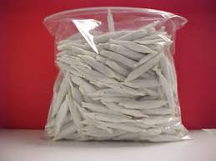
How much Marijuana does 1 ounce yield?
Approximately 84 cigarette sized joints
1 ounce = 6 plants
1 joint = 4 hours of intoxication
84 joints = 336 hours of high which equals 14 days of a continual high

Slide 6
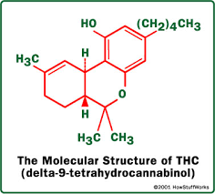
The chemical in marijuana that causes the user to feel “high” is Delta-9-tetrahydrocannabinol also known as THC.
There are more than 400 chemicals in marijuana but THC is the active ingredient responsible for increasing dopamine levels, the chemical in the brain that produces feelings of pleasure.

Slide 7
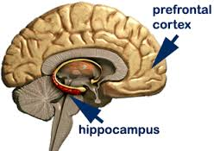
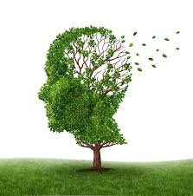
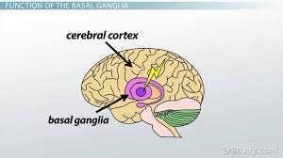
Marijuana users experience short term memory loss because of the drug’s effect on the hippocampus.
The hippocampus is the part of the brain involved in learning and memory. However, the basil ganglia is an area of the brain that helps control movement and that can be effected as well.

Slide 8
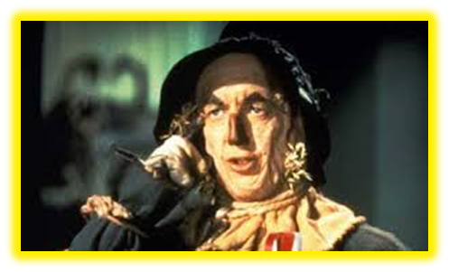
Think about your future……………….

